Slide 1
Projekt im Bachelor: MAPC
4. Milestone
Team: JNY Nader Jawhary, Yamen Sahyouni, Joakim Vik Haukedal
13.01.2022
Notes:
1

Slide 2
Brief Overview
Optimized and restructured code
Optimized spiral movement
Implemented blocked scenarios handling
Implemented communication/coordination plans (95% complete ☺)

Slide 3
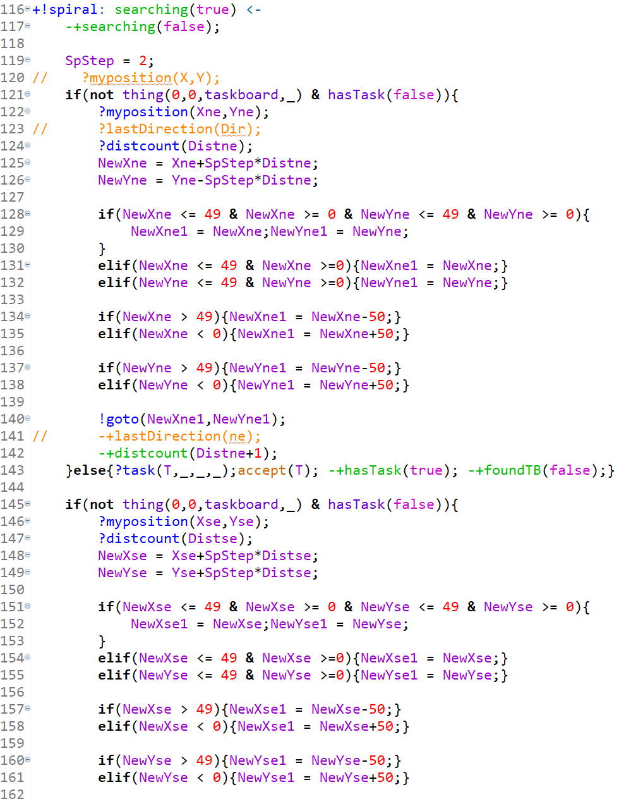
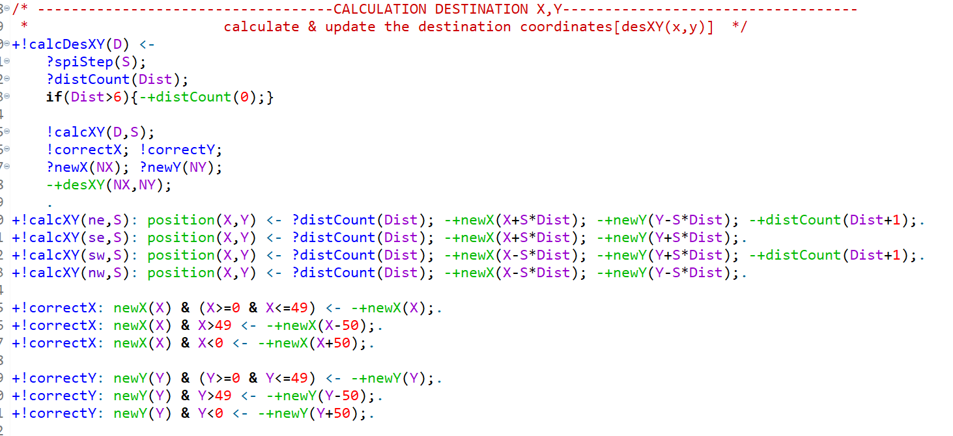
Old Code Optimized Code

Slide 4
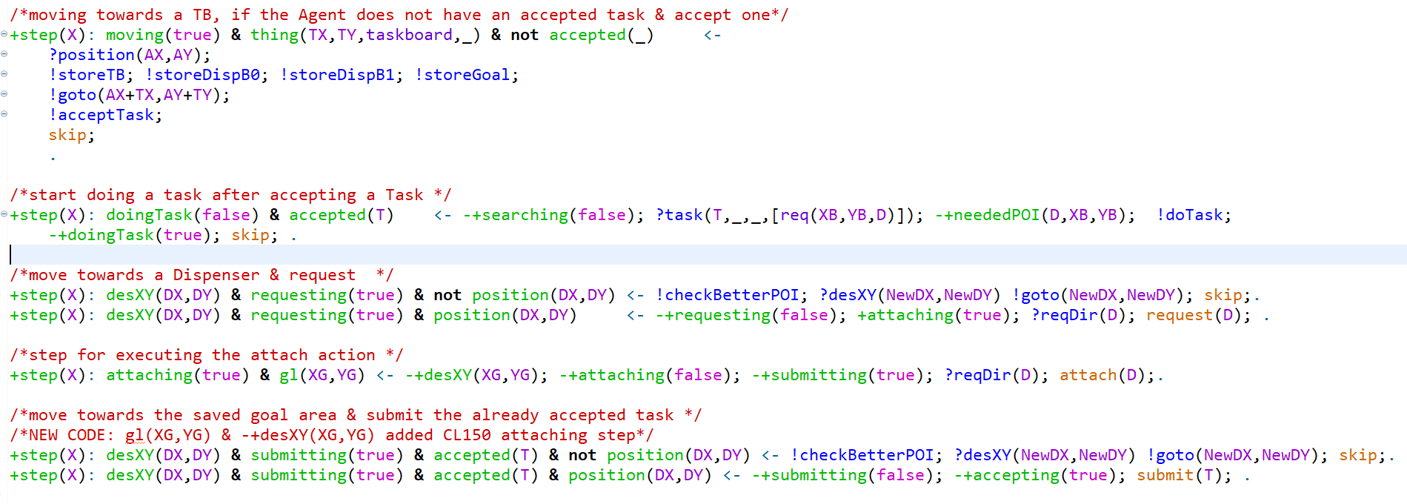
Code

Slide 5
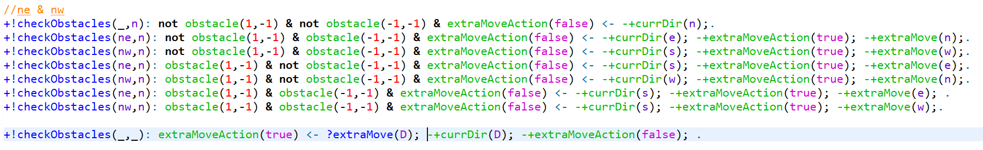
Code

Slide 6
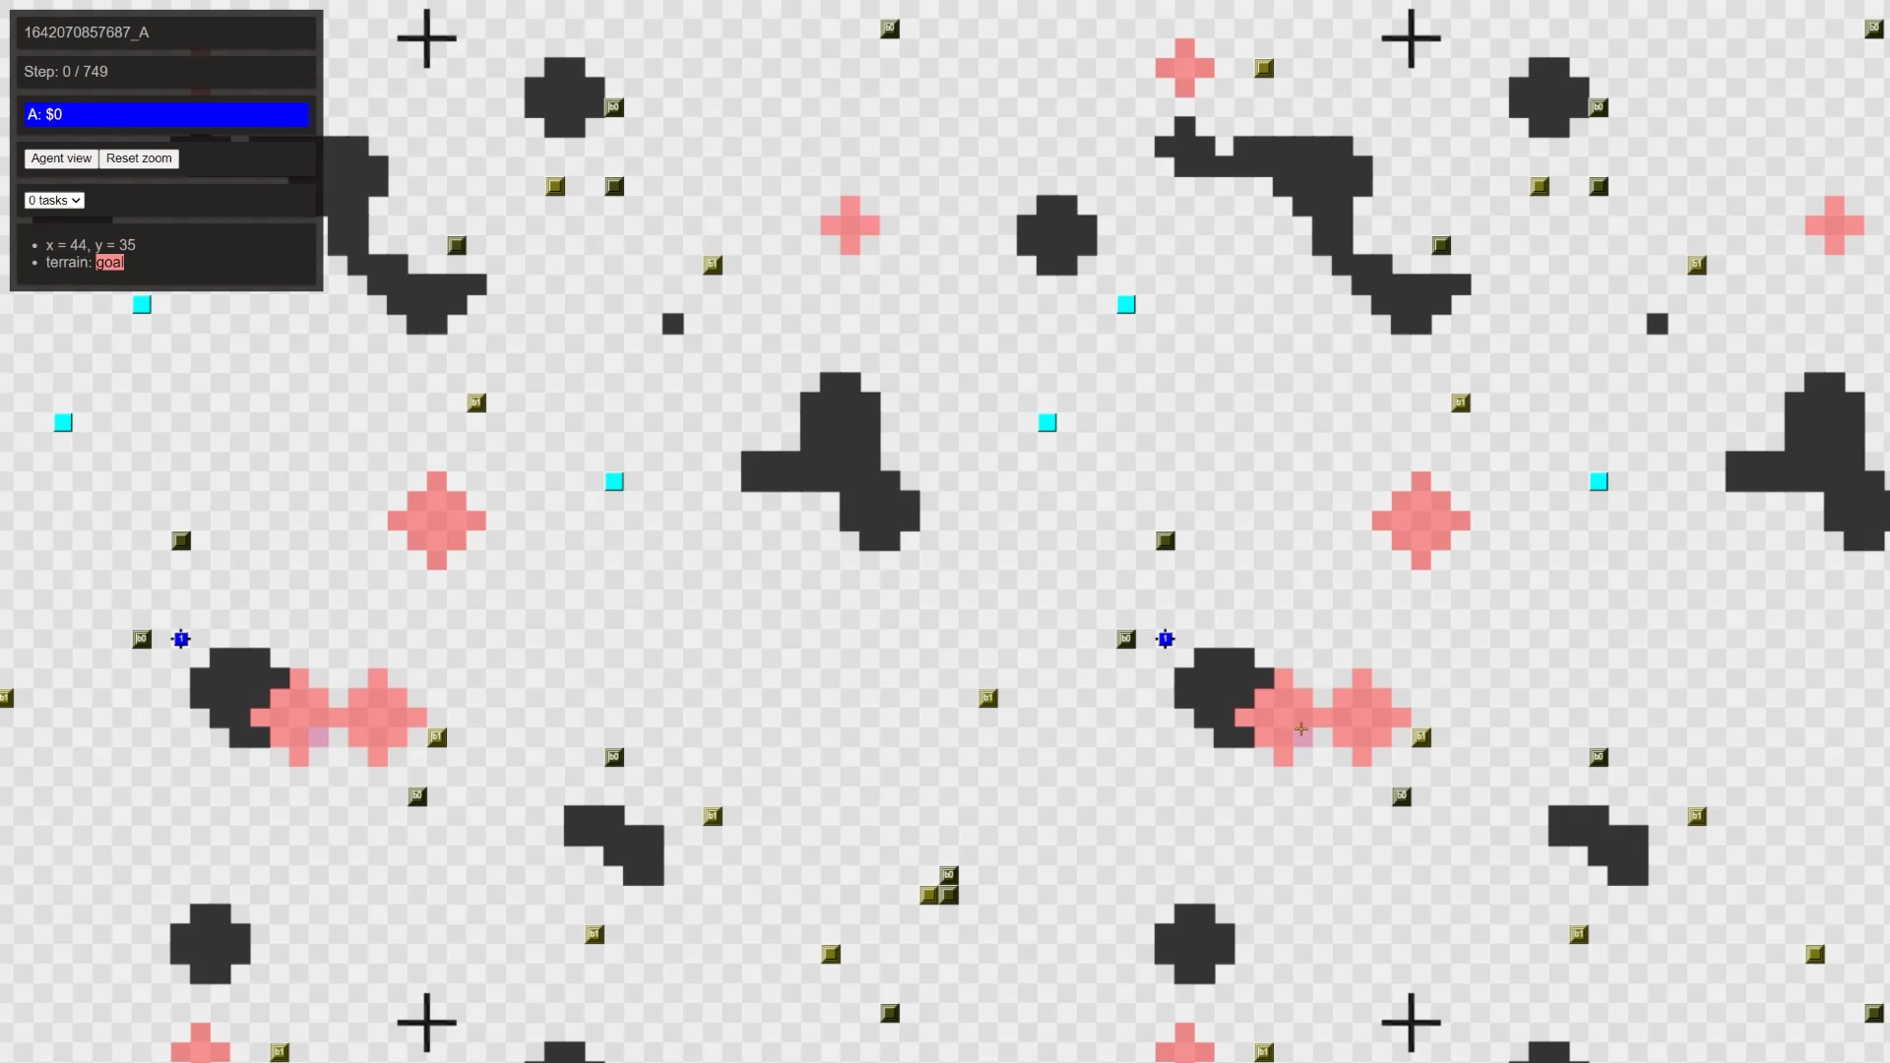

Slide 7
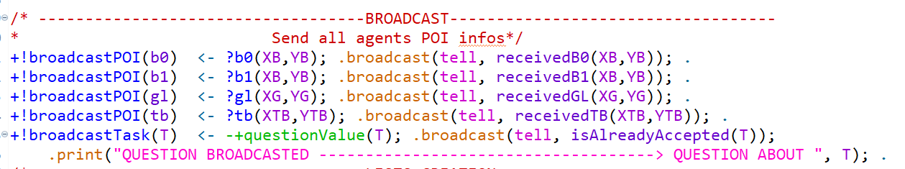
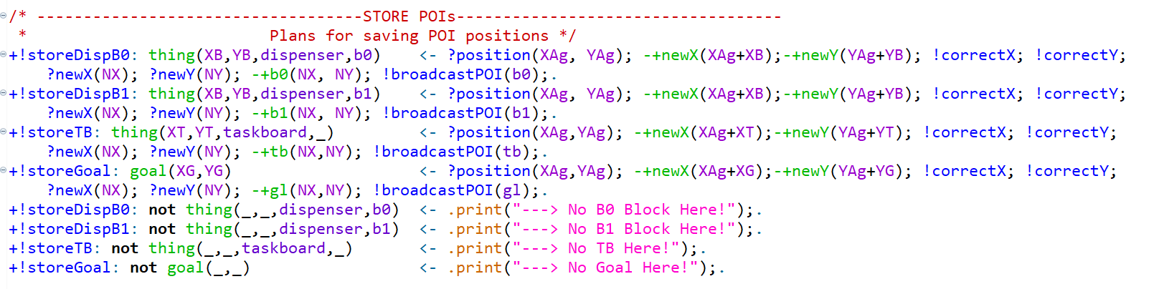
Code

Slide 8
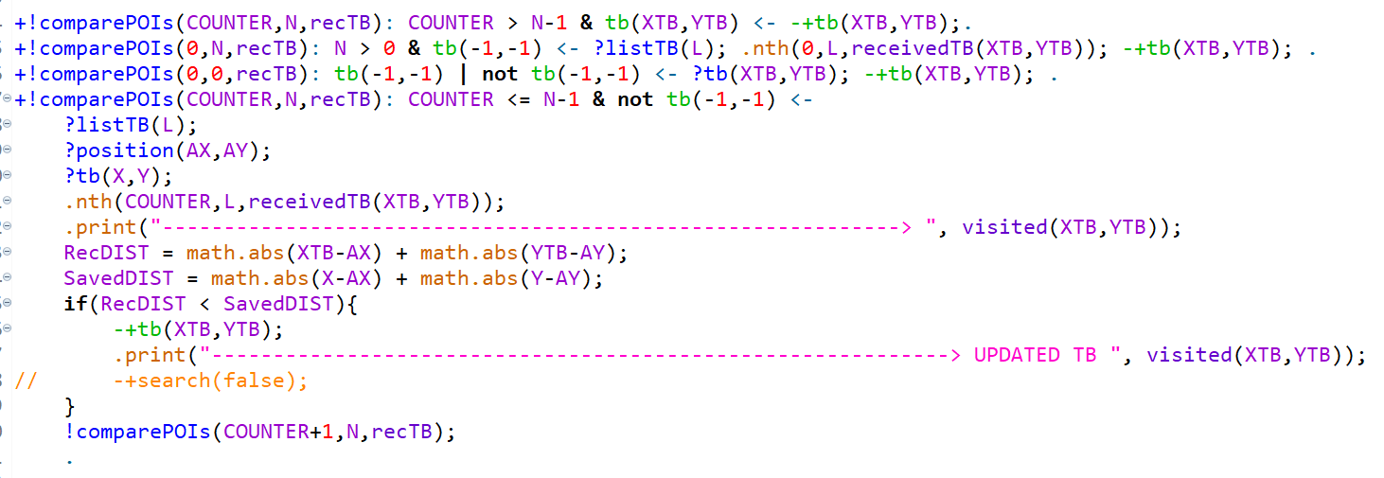
Code

Slide 9
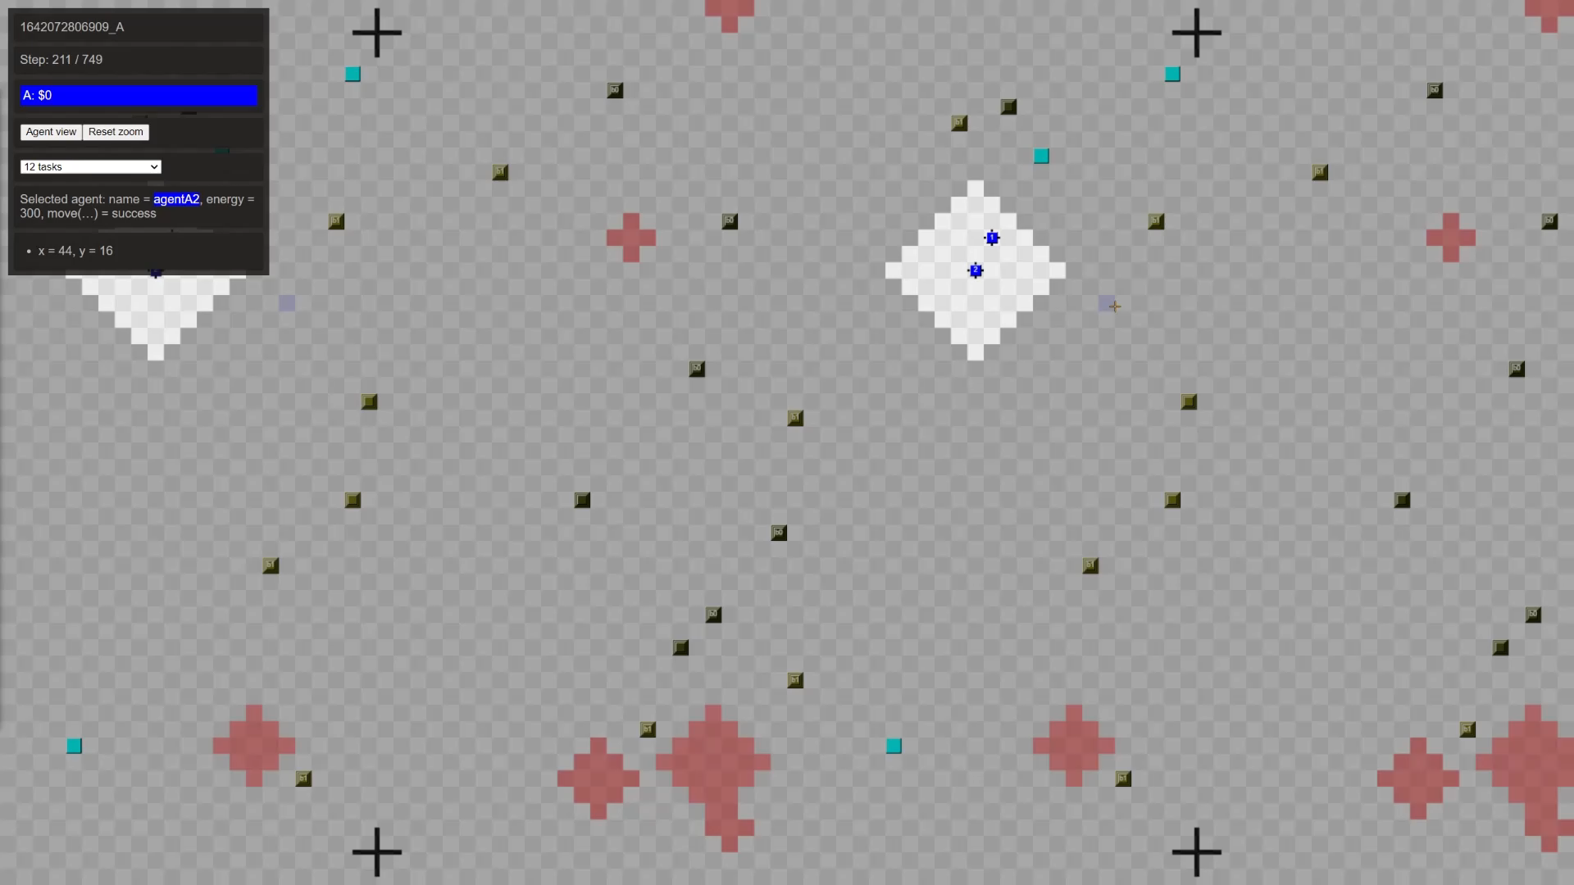
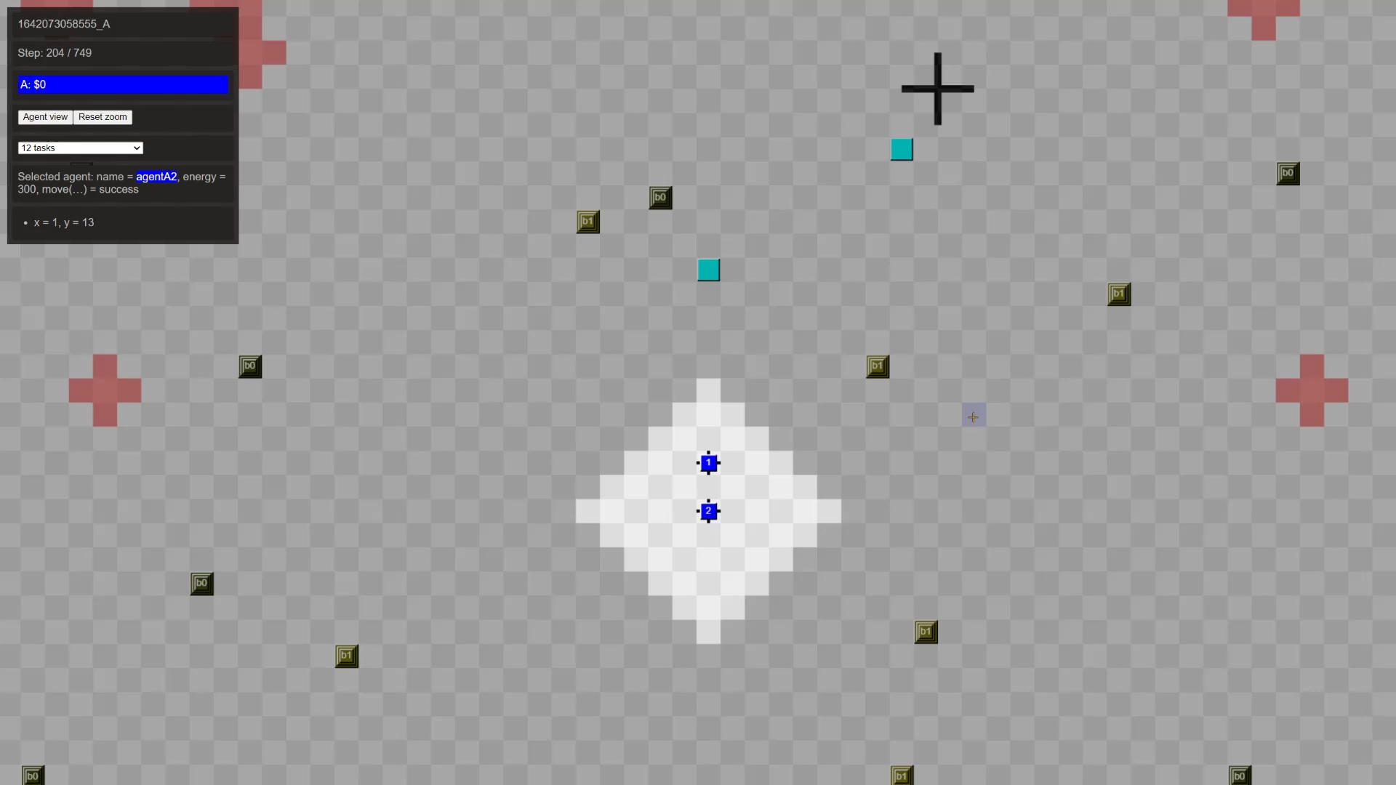

Slide 10
Problems solved
The agent “thinks” for several cycles without doing an action, afterwards it continues to work like normal
Skip for steps without actions
Overlap problem fixed
Deciding on closest POIs(Distance calculation fixed)

Slide 11
Problems
Blocked by Agent not fully functional
Communication is sometimes faster than actions
Possible Sol.: split into steps
Accepting tasks communication still buged
Sometimes same task accepted

Slide 12
Future plans
Multi block tasks
Solve problems

Slide 13
Thank you 😊

